Slide 1
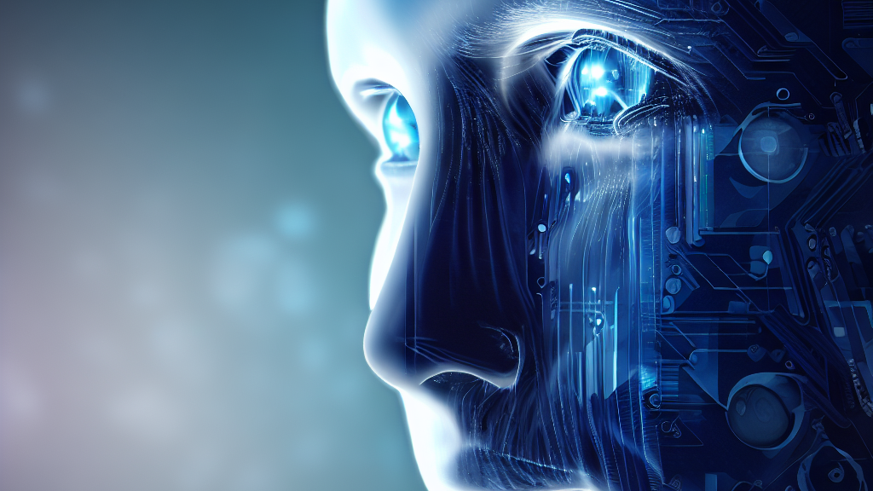


FACE DETECTION WITH PYTHON
VIVEKANANDA INSTITUTE OF TECHNOLOGY
AN INSTITUTE OF JANATHA EDUCATION SOCIETY
Recognised By GOK, Affiliated to VTU And Approved By AICTE, New Delhi
Department Of Information Science And Engineering
Under
Devminds internship
By:-
Mahesh A V_1VK21IS022_ML23115
Department of ISE
2023-24

Slide 2

Introduction
What is Face Detection?
Face detection is a computer vision technique used to locate and identify human faces within images or videos. It's a fundamental step in various applications, including photography, security systems, video surveillance, augmented reality, and social media.
Department of ISE
2023-24

Slide 3

Algorithm & Implementation Summary
Algorithm
1. Histogram of Oriented Gradients (HOG):
HOG is a feature descriptor technique used to extract gradient information from an image.
2. Support Vector Machine (SVM) Classifier:
VM is a supervised machine learning algorithm used for classification tasks.
Implementation
Image Loading: Read and prepare images for analysis.
Face Encoding: Generate numeric encodings representing known faces in the images.
Face Detection: Identify and locate faces within the images using face_recognition.
Comparison and Labeling: Match detected faces with known faces using their encodings and label accordingly.
Department of ISE
2023-24

Slide 4
Tools Used
OpenCV
Feature
1.Image Processing
2.Video Analysis
3.Object Detection and Recognition
4.Machine Learning Integration
5.Feature Detection and Matching
Capabilities
1.Cross-platform and Language Support
2.Performance and Optimization:
3.Performance and Optimization:
4.Extensibility and Flexibility:
5.Real-time Applications:
face_recognition Library
Functionality
1. Face Detection:
2. Face Encoding:
3. Face Recognition
Advantages
1 Simplicity and Accessibility:
2. Quick Prototyping and Development
3. Pre-trained Models:
4. Integration with Python Ecosystem:
Department of ISE
2023-24

Slide 5
SWOT Analysis
Strengths | OpenCV: Offers a diverse set of computer vision tools, high-performance algorithms, and cross-platform support with a vibrant community. face_recognition: Features a simplified interface for accessible face-related tasks, facilitates rapid prototyping with a user-friendly API, and provides pre-trained models for face-related tasks.
Weaknesses | OpenCV: Presents a steep learning curve, resource-intensive operations, and occasional documentation gaps. face_recognition: Exhibits limited customization, relies on the underlying dlib library for performance, and may face scalability issues with large datasets.
Opportunities | OpenCV Opportunities: Improve tutorials, optimize algorithms, and expand technology integration. face_recognition Opportunities: Enhance efficiency, add customization, and extend capabilities beyond face recognition.
Threats | Market Competition Threats: Emerging specialized libraries and potential loss of market share due to increased competition. Technological Advancements Threats: Rapid advancements may render current methods obsolete, risking reduced relevance if unable to adapt.
Department of ISE
2023-24

Slide 6
Conclusion with Metrics
Performance Metrics:
Accuracy: Achieved accuracy rates in face detection tasks.
Speed: Measurement of the processing speed for real-time applications.
Efficiency: Resource utilization and computational efficiency metrics.
Observations from the Implementation:
Challenges: Notable difficulties encountered during implementation (e.g., lighting variations, pose changes).
Strengths: Identified strong points and advantages of the implemented system.
Areas for Improvement: Highlighted aspects requiring enhancement or optimization.
Results Achieved in Face Detection:
Accuracy Rates: Specific accuracy percentages obtained in detecting faces.
Real-time Performance: Speed and efficiency achieved in processing live video streams.
Robustness: Ability to detect faces under varying conditions and challenging scenarios.
Department of ISE
2023-24

Slide 7

Department of ISE
2023-24

Slide 8

Department of ISE
2023-24

